Slide 1
Regression Models
Simple Linear Regression
Multi Linear Regression
Polynomial
Regression
Works with non-linear relationship
Modeled as: y = θₒ+ θ₁X + θ₂X²
Overfitting
Multicollinarity
Strong relationship between indepVars (Torque, horsepower)
One has to be dropped
Regularization needed

Slide 2
Simple Linear Regression
DepVar
Weight
Observed
eᵢ = yᵢ-ŷ
Predicted
Size
IndepVars
This regression finds the best fit line by minimizing the squares of the errors (SoE)
Σeᵢ = Σ(yᵢ-ŷ)²

Slide 3
Method of Least Squares
DepVar
Observed
Weight
Predicted
Intercept
Size
IndepVars

Slide 4
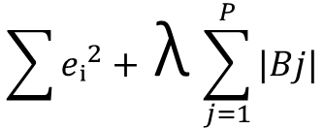
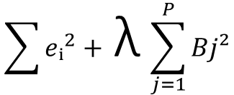
Regularization of Least Squares
Ordinary Least Square
Σeᵢ² = Σ(yᵢ-ŷ)²
Regularization
Adds penalty
Ridge (L2 form)
Lasso (L1 form)
$$\sum{eᵢ^{2}+ }\text{λ}\sum_{j=1}^{P}{Bj²}$$
$$\sum{eᵢ^{2}+ }\text{λ}\sum_{j=1}^{P}{|Bj|}$$

Slide 5
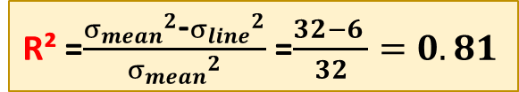

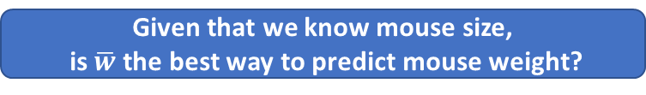
R² : Percentage of the variation explained by the relationship between two variables
There is %81 less variation around the line than mean
Or
Szie/Weight rel accounts for %81 of the variation
So: Most of the variation in data is explained by size/weight rel
Weight
Mean
R² =$\frac{{σ_{mean}}^{2}\text{-}{σ_{line}}^{2}}{{σ_{mean}}^{2}}$ =$\frac{32−6 }{32}=0.81$
Variation around the mean
Why square: points below mean don’t cancel out points above mean
${σ_{mean}}^{2}$= (wᵢ-$\overline{w}$)²
Now we can predict
ID
Fit a line to data
It looks like red line fits the data better than mean
How to quantify this «better» -→R²
No
Weight
Mean
Variation around the line
Given that we know mouse size,
is $\overline{w}$ the best way to predict mouse weight?
size
IndepVars

